Slide 1

Predicting MLB Pitches
Metis Final Project
Patrick Bovard
Notes:
Image: https://cdn.pixabay.com/photo/2016/08/02/15/47/baseball-field-1563858_960_720.jpg

Slide 2
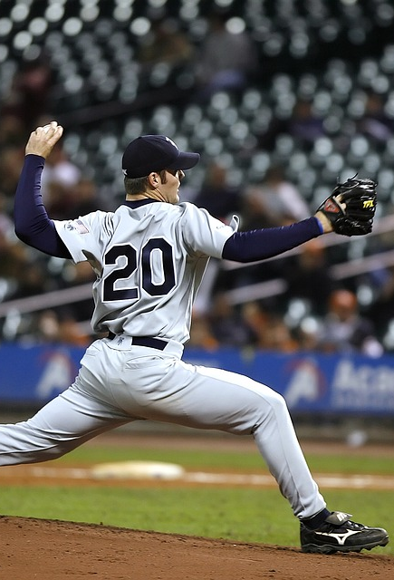
Agenda
Motivation and Goals
Data Collection and Modeling
Results and Takeaways
Future Improvements
Notes:
Image: https://cdn.pixabay.com/photo/2016/07/08/18/29/baseball-1505036_1280.jpg

Slide 3

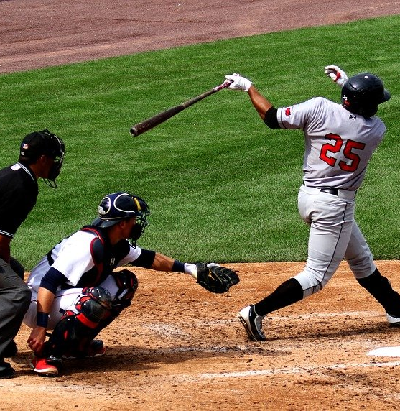
It takes 0.425 seconds for a 95 mile per hour pitch to reach home plate.
Within that time batter needs to:
Identify pitch type
Identify location
Decide whether or not to swing
Swing
Hit the ball
How is this possible?
Guessing
Sign stealing
Studying / Preparation
Can Machine Learning help?

Slide 4
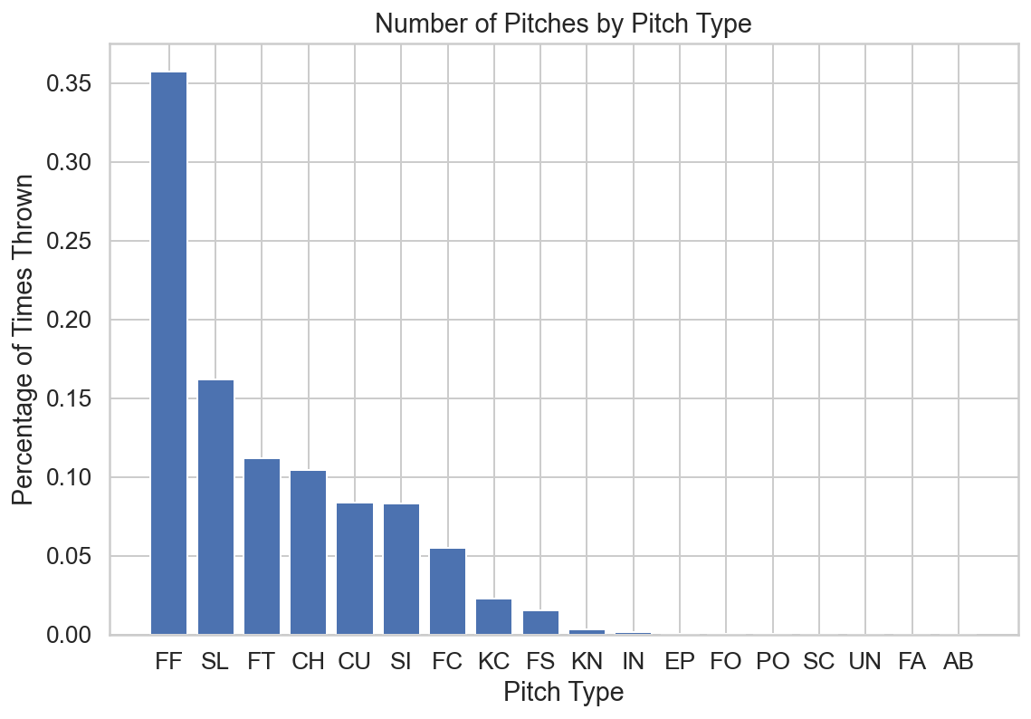
Data from every MLB Pitch over 2015-2019 was utilized in this project
~3.5 million total pitches
~18 pitch types
Kaggle Dataset from Paul Schale
Supplementary Data:
Hitting Statistics from FanGraphs
Project Goal: Develop two sequential predictive models:
Pitch Type – Classification
Pitch Location – Regression
KEY: Features must be known by the batter before the pitch!

Slide 5






General Project Timeline and Tools
Data Collected from Kaggle
- Pitches, At-Bats, Games, Players Tables
K-Means Clustering of Hitter Statistics
PostgreSQL Database created and queried
- Features for modeling joined
- Pitcher Stats engineered
- Data Cleaning
- Exploratory Data Analysis
- Modeling Preparation
Multiclass Classification Modeling
- XGBoost / Random Forest Classifiers
Regression for Pitch Location X and Y Coordinates
- Linear Regression, Random Forest Regressor
Notes:
- Kaggle Image:

Slide 6
The final models included features from three “buckets”:
Game Situation:
Outs, Balls, Strikes, Runners on Base, Score
Batter Info:
Hitter “Cluster”, Hitting Side
Pitcher Stats:
Total pitches thrown, last pitch information, running pitch type breakdown

Slide 7
Individual final models were trained and validated for 50 pitchers.
Metric | Value
Pitch Type: XGBoost Classifier

Slide 8
Individual final models were trained and validated for 50 pitchers.
Metric | Value
Avg. Pitch Type Prediction Accuracy | 31%
Pitch Type: XGBoost Classifier

Slide 9
Individual final models were trained and validated for 50 pitchers.
Metric | Value
Avg. Pitch Type Prediction Accuracy | 31%
Avg. Non-Primary Pitch Prediction Precision | 23%
Avg. Non-Primary Pitch Prediction Recall | 23%
Pitch Type: XGBoost Classifier

Slide 10
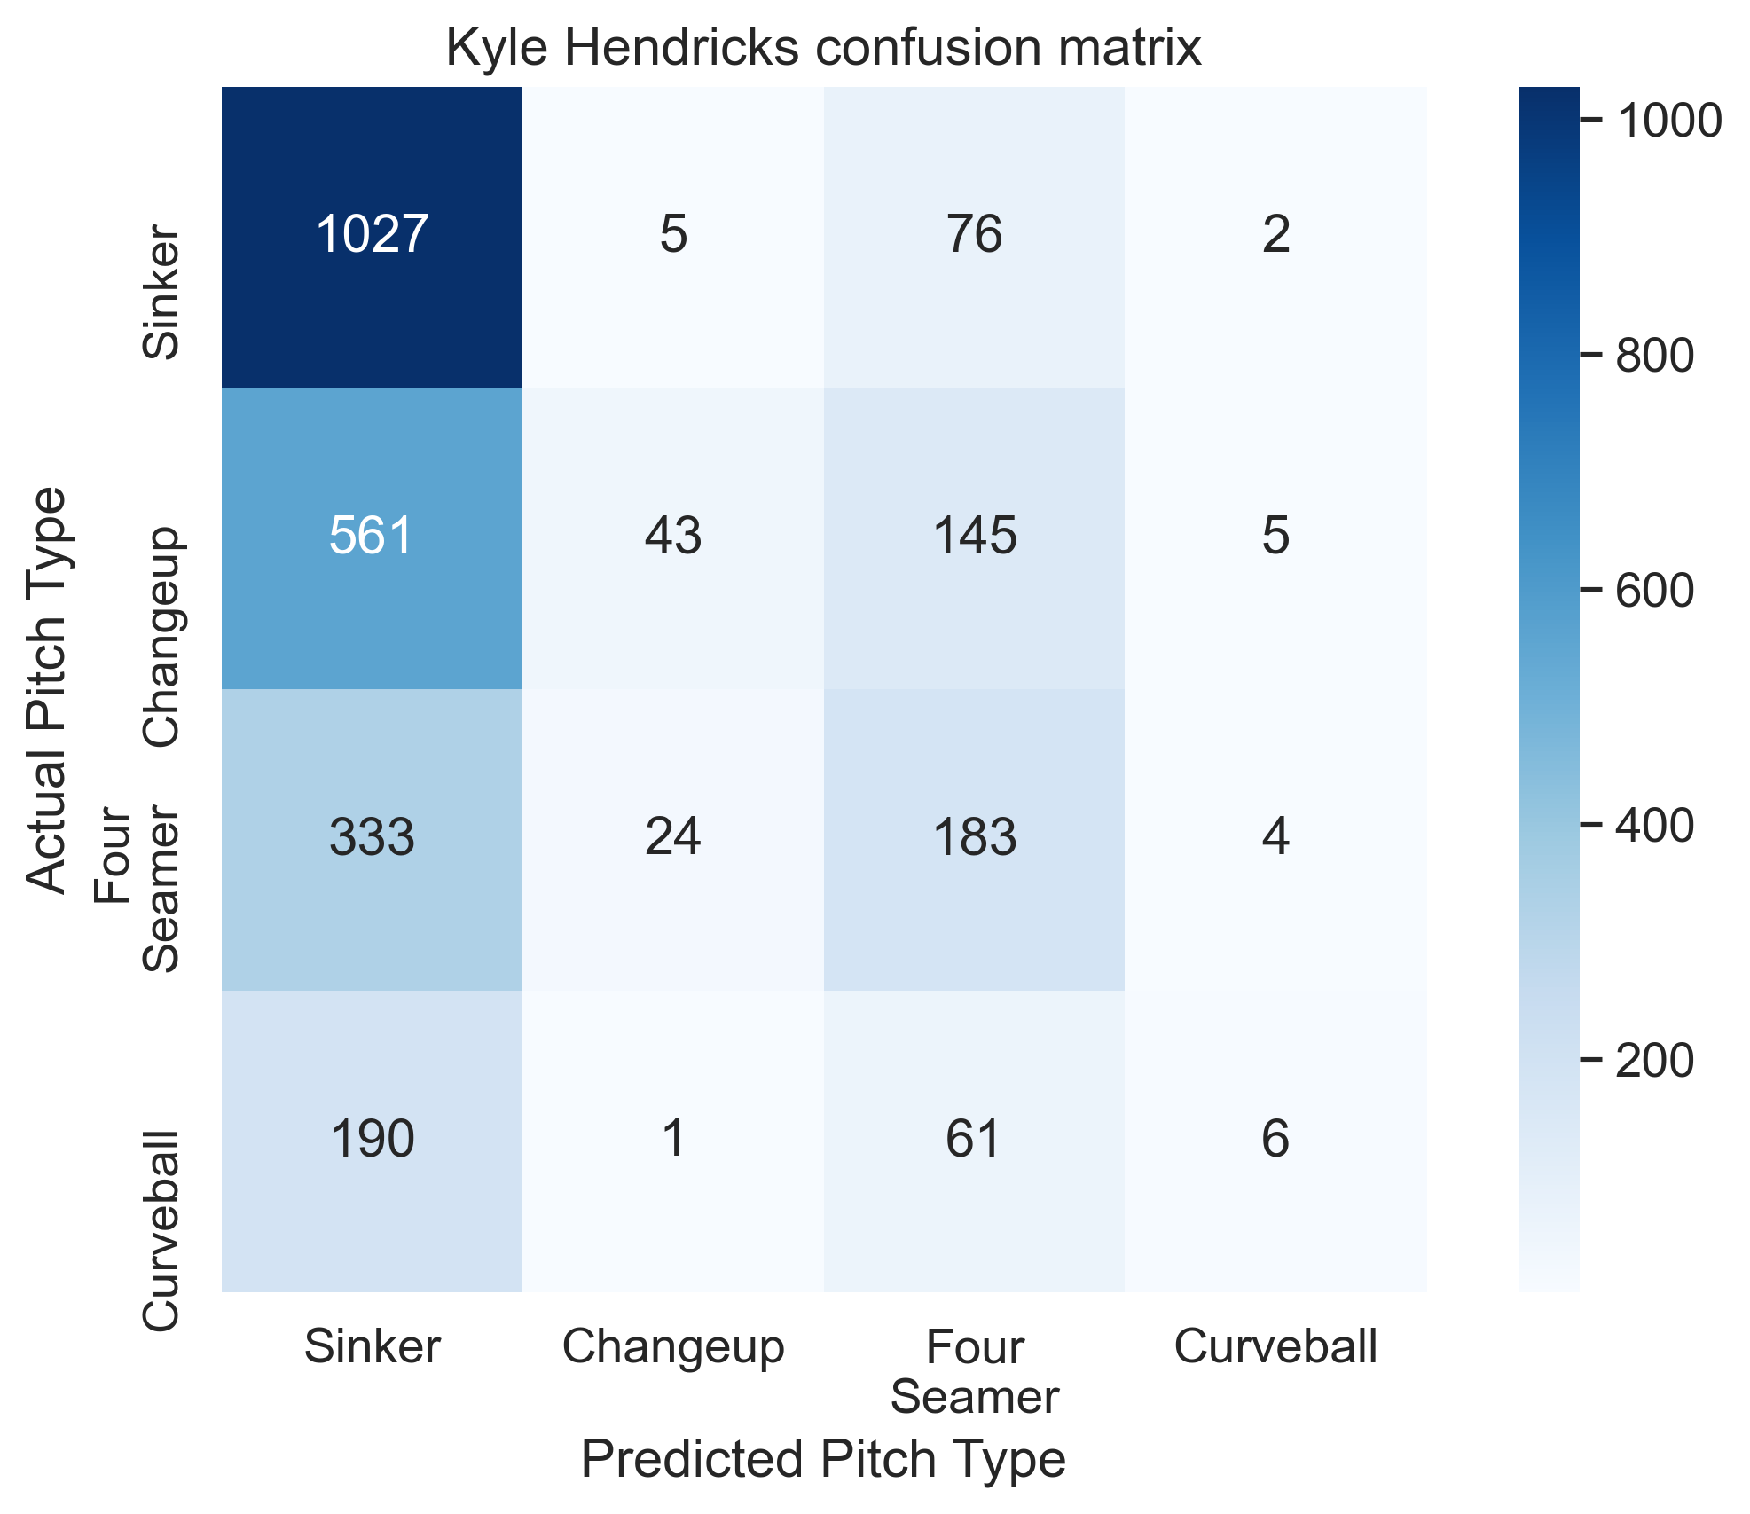
Kyle Hendricks’ pitch arsenal was predicted with the highest precision and recall for non-primary pitches
Accuracy: 47% | Precision: 46%
Recall: 34%
Pitch Arsenal (w/ pitch rate):
Sinker: 47%
Establishes hitters with a sinker/changeup mix, doesn’t rely on four seam velocity
Changeup: 27%
Four Seam Fastball: 13%
Cutter: 5%
Curveball: 8%
Notes:
Verlander Pic: https://a.espncdn.com/i/headshots/mlb/players/full/6341.png

Slide 11
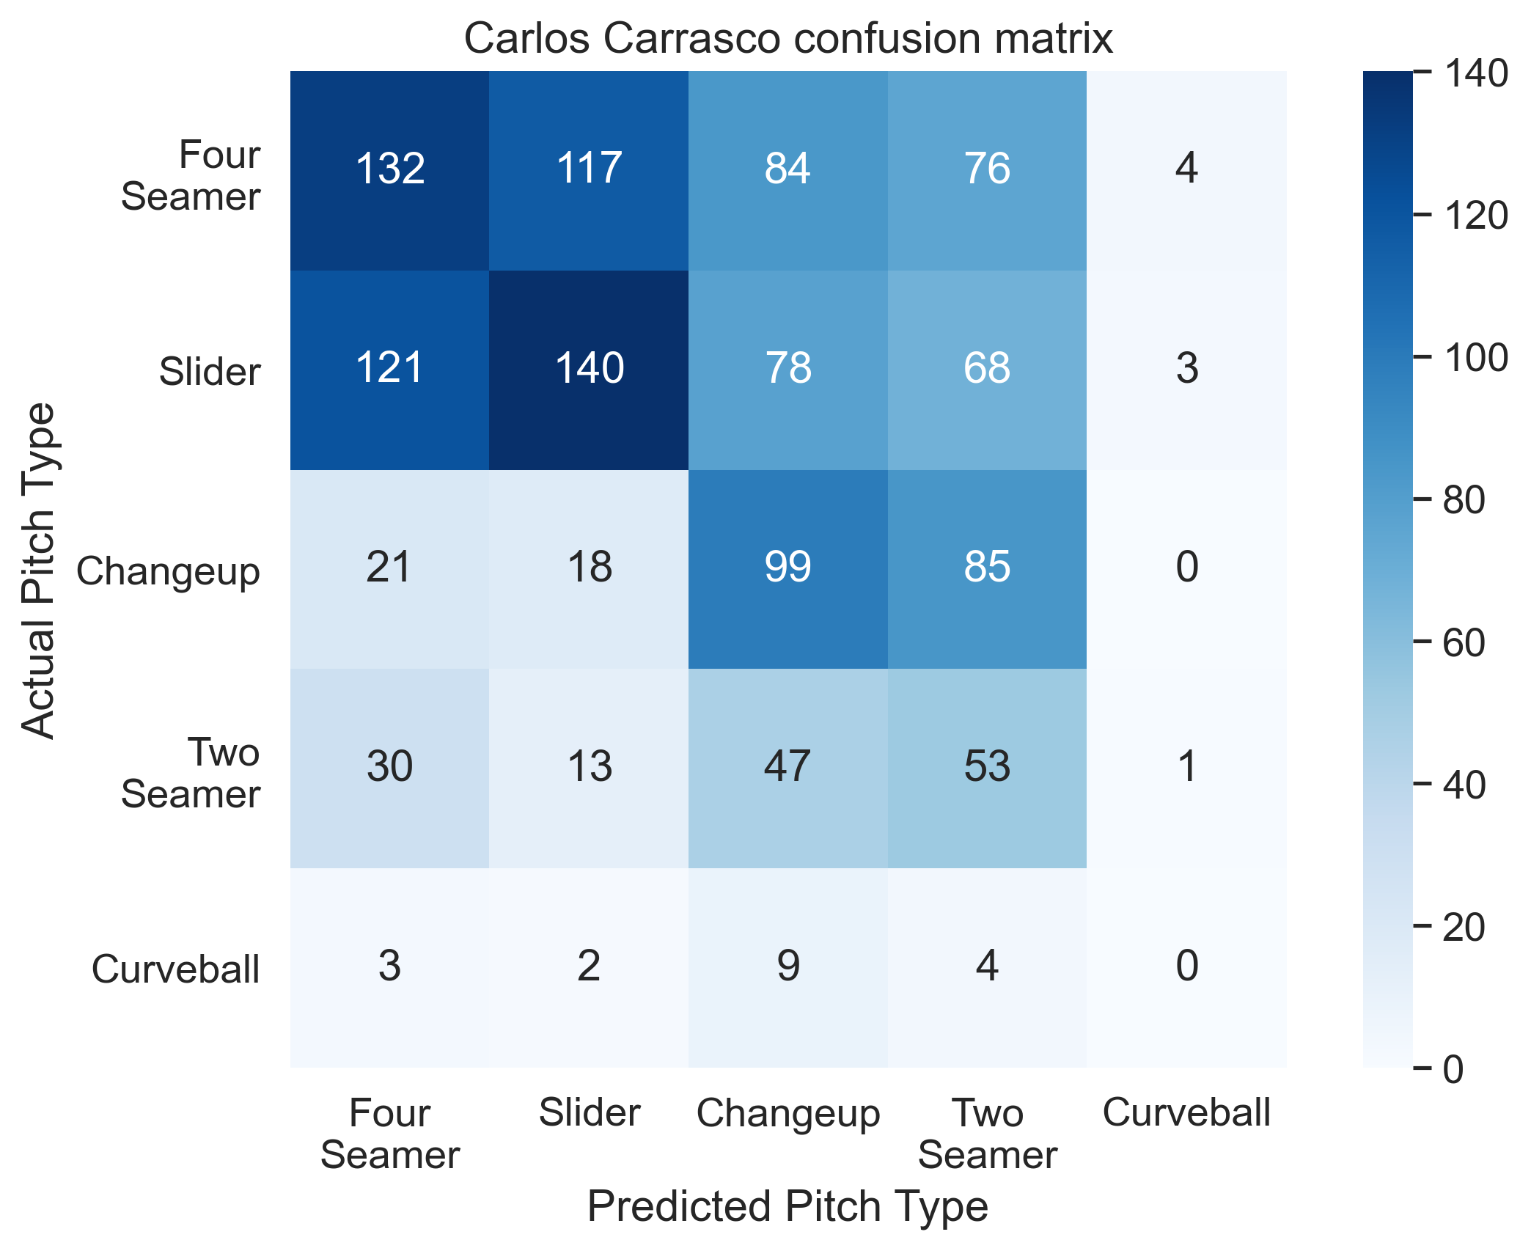
The model predicted Carlos Carrasco’s pitches well when considering the second most likely pitch
Accuracy: 35% | Precision: 28%
Recall: 29%
Pitch Arsenal (w/ pitch rate):
Four Seam Fastball: 36%
Second most likely pitch type matched the actual pitch type 47% of the time
Slider: 21%
Curveball: 11%
Two Seamer: 14%
Changeup: 18%
Notes:
Verlander Pic: https://a.espncdn.com/i/headshots/mlb/players/full/6341.png

Slide 12
The model struggled with pitchers who drastically changed pitch types, like Chris Sale
Accuracy: 23%
Precision: 32%
Recall: 28%
- Sinker Usage fell drastically in 2017
- Replaced with Four seam fastball
Image Credit: Baseball Savant
Notes:
Verlander Pic: https://a.espncdn.com/i/headshots/mlb/players/full/6341.png

Slide 13
Individual final models were trained and validated for 50 pitchers.
Metric | Value
Pitch Location: Linear Regression
X Coordinate First
Y Coordinate Second

Slide 14
Individual final models were trained and validated for 50 pitchers.
Metric | Value
Avg. X Coordinate Mean Average Error | 7.76 in.
Avg. Y Coordinate Mean Average Error | 8.25 in.
Pitch Location: Linear Regression
X Coordinate First
Y Coordinate Second

Slide 15
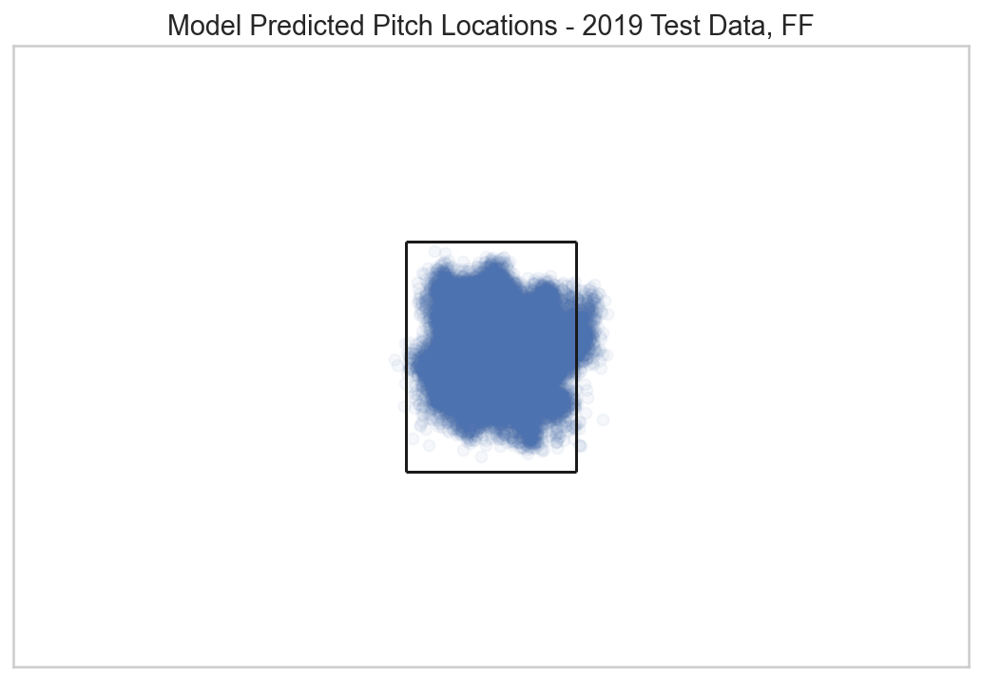
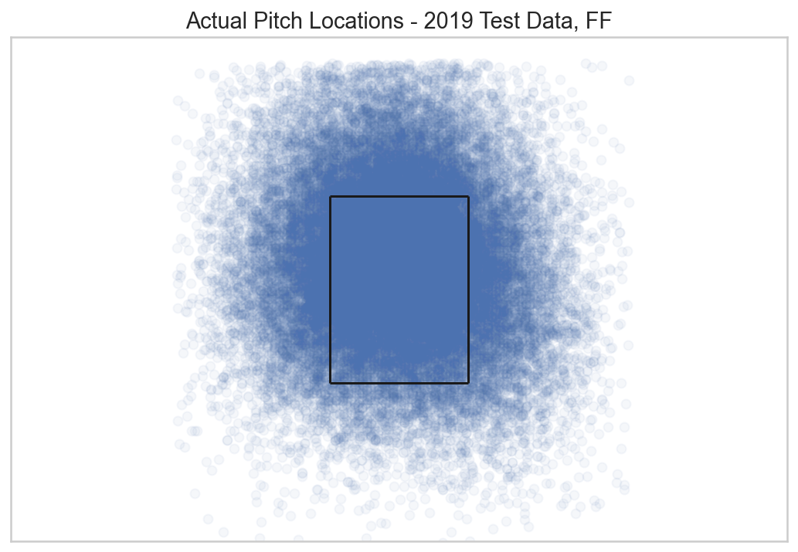
Predicted pitch locations tended to predict with more concentration within the strike zone, replicating intent of the pitch
Four Seam Fastball: Middle of the zone, upper portion

Slide 16
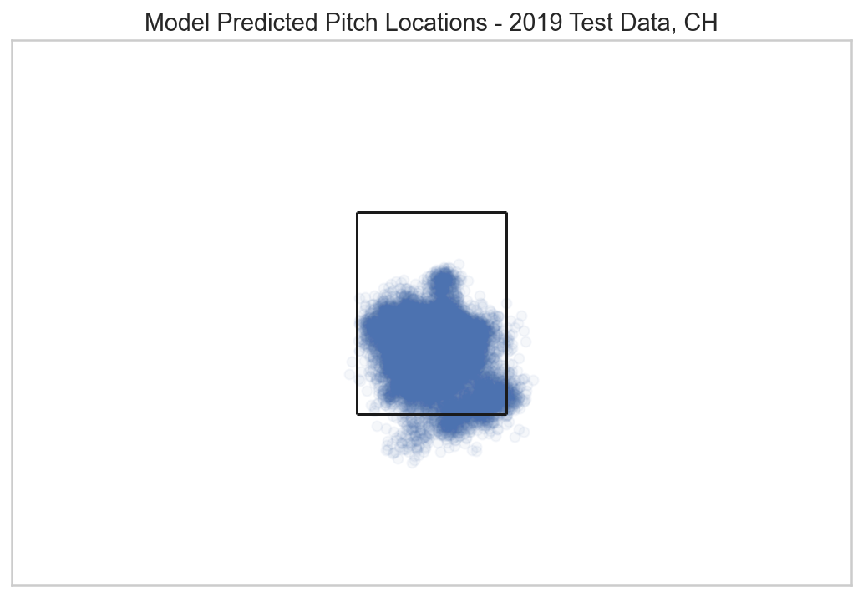
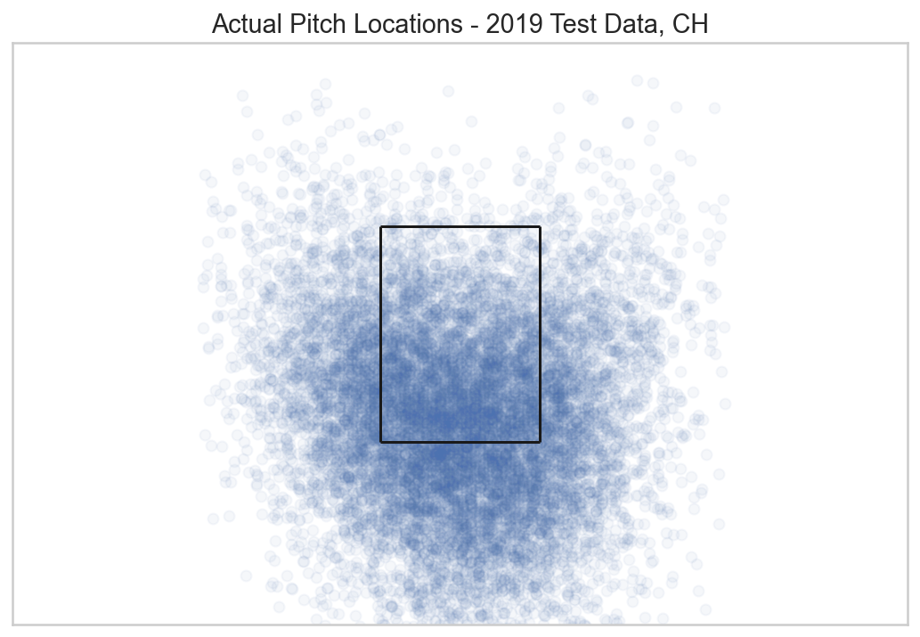
Predicted pitch locations tended to predict with more concentration within the strike zone, replicating intent of the pitch
Changeup: Lower in the zone, trending towards the right-side edge

Slide 17

Future Improvements
Web App Development
Individual hyptertuning of pitcher models
Continued feature engineering to improve prediction

Slide 18



Thank you!
Feel free to connect on LinkedIn or check out my project on GitHub!
LinkedIn: https://www.linkedin.com/in/patrick-bovard/
GitHub Repository: https://github.com/pbovard63/Predicting_MLB_Pitches

Slide 19

Appendix
Notes:
Image Address: https://cdn.pixabay.com/photo/2016/04/26/18/01/softball-1354947_960_720.jpg

Slide 20
50 Pitchers included in final model:
Max Scherzer, Justin Verlander', 'Chris Archer', 'Jose Quintana', 'Chris Sale', 'Rick Porcello', 'Jon Lester', 'Corey Kluber', 'Gio Gonzalez', 'Julio Teheran', 'Jake Arrieta', 'Zack Greinke', 'Cole Hamels', 'Trevor Bauer', 'Gerrit Cole', 'Jacob deGrom', 'Dallas Keuchel', 'Jake Odorizzi', 'James Shields', 'Kyle Gibson', 'Marco Estrada', 'J.A. Happ', 'Kevin Gausman', 'Tanner Roark', 'Mike Fiers', 'Ian Kennedy', 'Mike Leake', 'Kyle Hendricks', 'David Price', 'Carlos Martinez', 'Carlos Carrasco', 'Andrew Cashner', 'Jeff Samardzija', 'Madison Bumgarner', 'Jason Hammel', 'Masahiro Tanaka', 'CC Sabathia', 'Robbie Ray', 'Wade Miley', 'Clayton Kershaw', 'Danny Duffy', 'Bartolo Colon', 'Patrick Corbin', 'Sonny Gray', 'Chase Anderson', 'Johnny Cueto', 'Francisco Liriano', 'Hector Santiago', 'Jordan Zimmermann', 'Felix Hernandez'

Slide 21
Final Model Features:
Classification:
'Cluster','inning', 'top', 'on_1b', 'on_2b', 'on_3b', 'b_count', 's_count', 'outs', 'stand_R’, 'pitcher_run_diff','last_pitch_speed', 'last_pitch_px’, 'last_pitch_pz','pitch_num','cumulative_pitches’, 'cumulative_ff_rate', 'cumulative_sl_rate', 'cumulative_ft_rate’, 'cumulative_ch_rate', 'cumulative_cu_rate', 'cumulative_si_rate’, 'cumulative_fc_rate', 'cumulative_kc_rate', 'cumulative_fs_rate’, 'cumulative_kn_rate', 'cumulative_ep_rate', 'cumulative_fo_rate’, 'cumulative_sc_rate', 'Last_Pitch_Type_Num', 'last_5_ff', 'last_5_sl', 'last_5_ft', 'last_5_ch’, 'last_5_cu', 'last_5_si', 'last_5_fc', 'last_5_kc’, 'last_5_fs', 'last_5_kn', 'last_5_ep', 'last_5_fo’
Regression – Px:
'Cluster','inning', 'top', 'on_1b', 'on_2b', 'on_3b', 'b_count', 's_count', 'outs', 'stand_R’, 'pitcher_run_diff','last_pitch_speed', 'last_pitch_px', 'last_pitch_pz','pitch_num','cumulative_pitches’, 'Last_Pitch_Type_Num', 'Pitch_Type_Num’
Regression – Pz:
'Cluster','inning', 'top', 'on_1b', 'on_2b', 'on_3b', 'b_count', 's_count', 'outs', 'stand_R’, 'pitcher_run_diff','last_pitch_speed', 'last_pitch_px’, 'last_pitch_pz','pitch_num','cumulative_pitches’, 'Last_Pitch_Type_Num', 'Pitch_Type_Num', 'px'

Slide 22
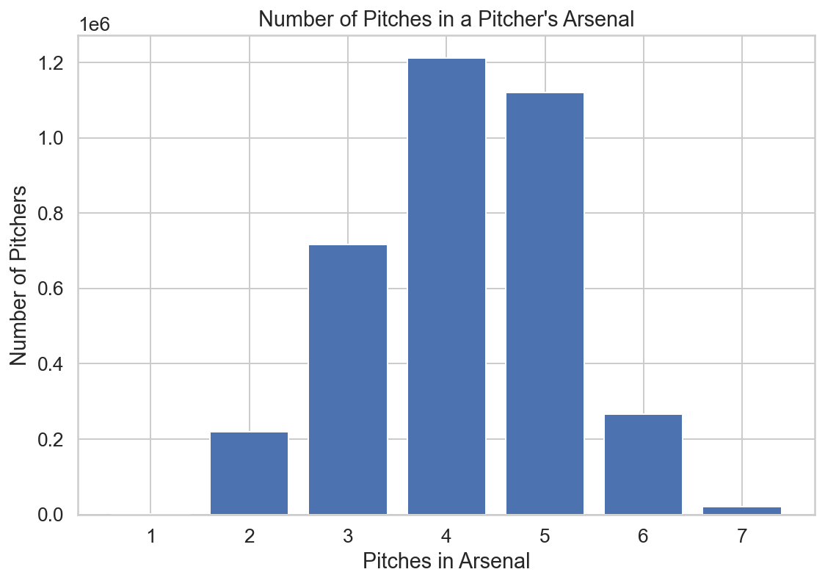
Different pitchers throw different numbers of pitches, complicating predictions
Solution: Individual models for each different pitcher

Slide 23
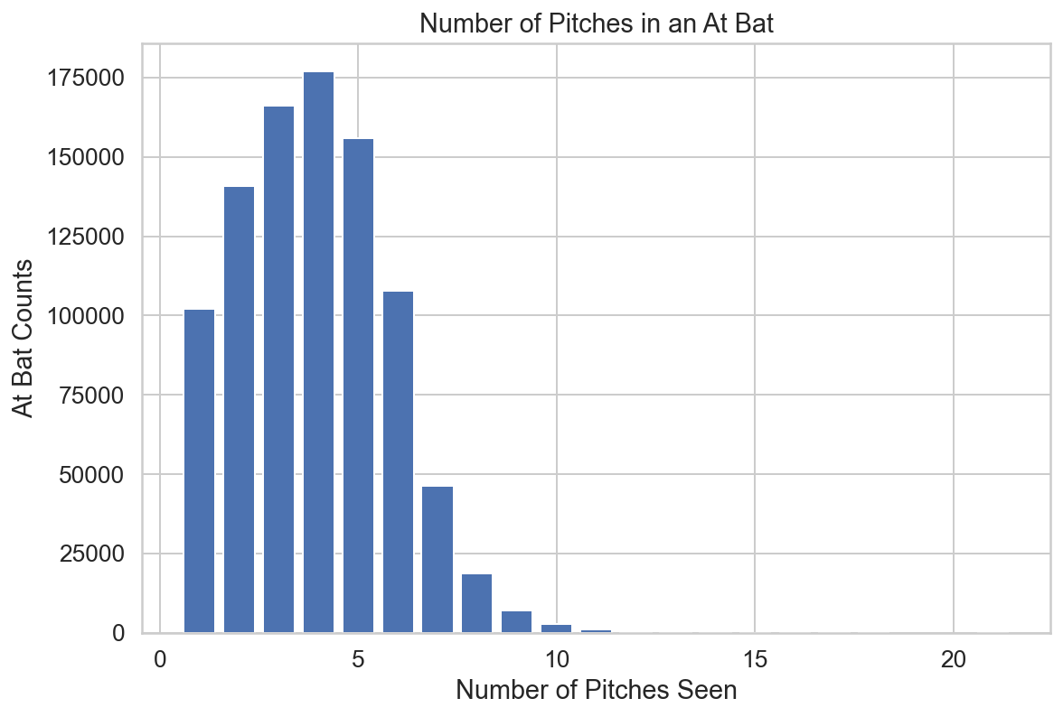
Pitches in an at bat have a definitive right tail.

Slide 24
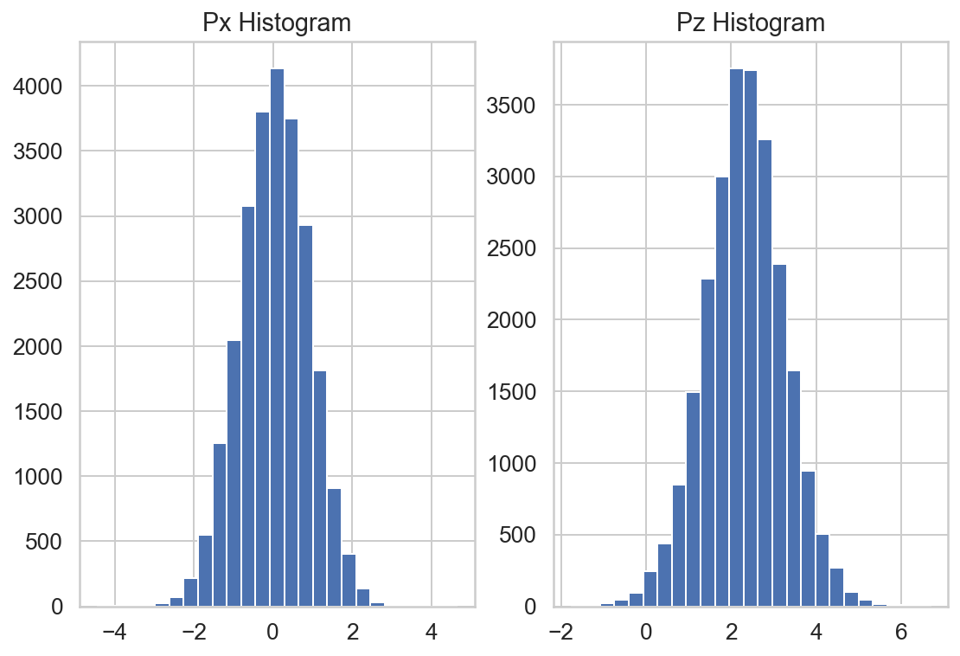
Pitch location shows a relatively normal distribution for the two coordinates.

Slide 25
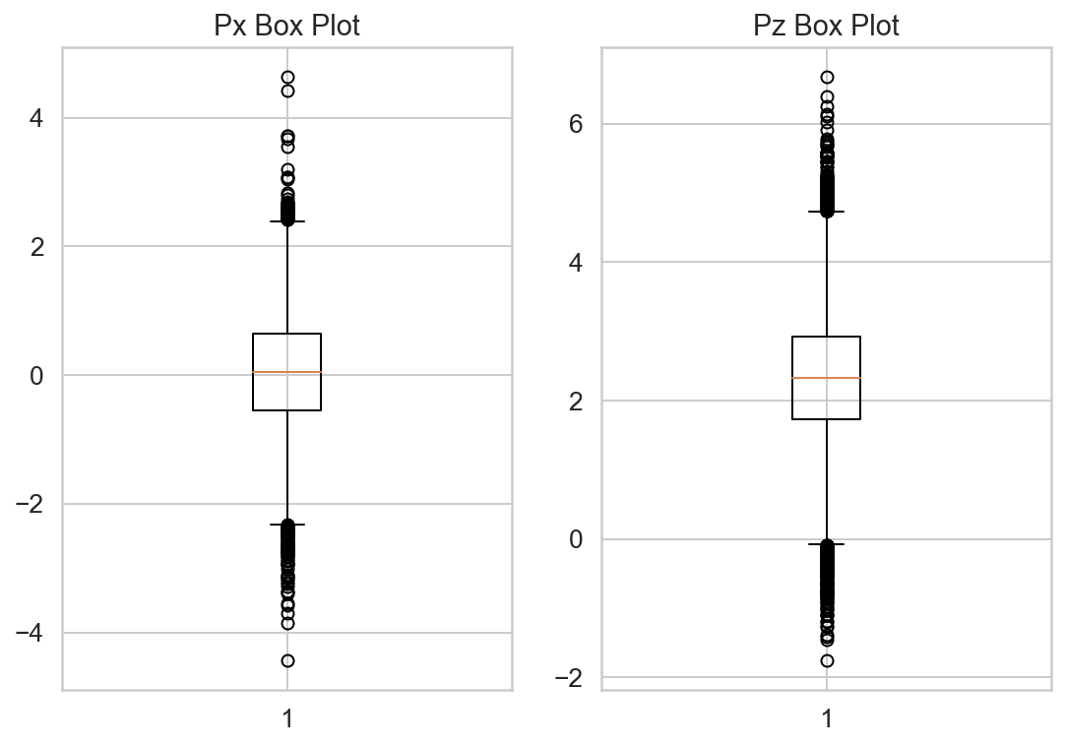
Both Px and Pz showed a high number of outlier points.

Slide 26
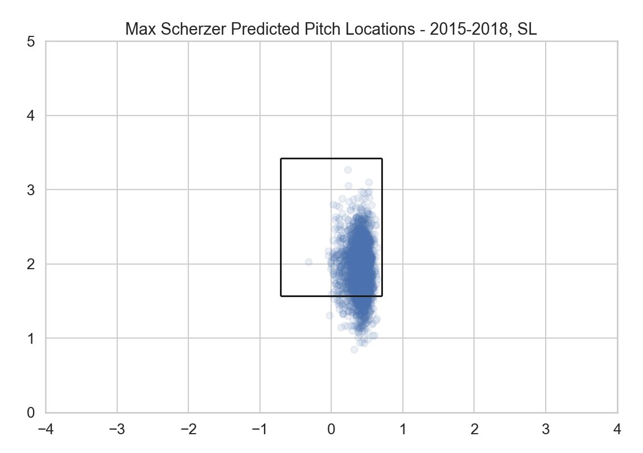
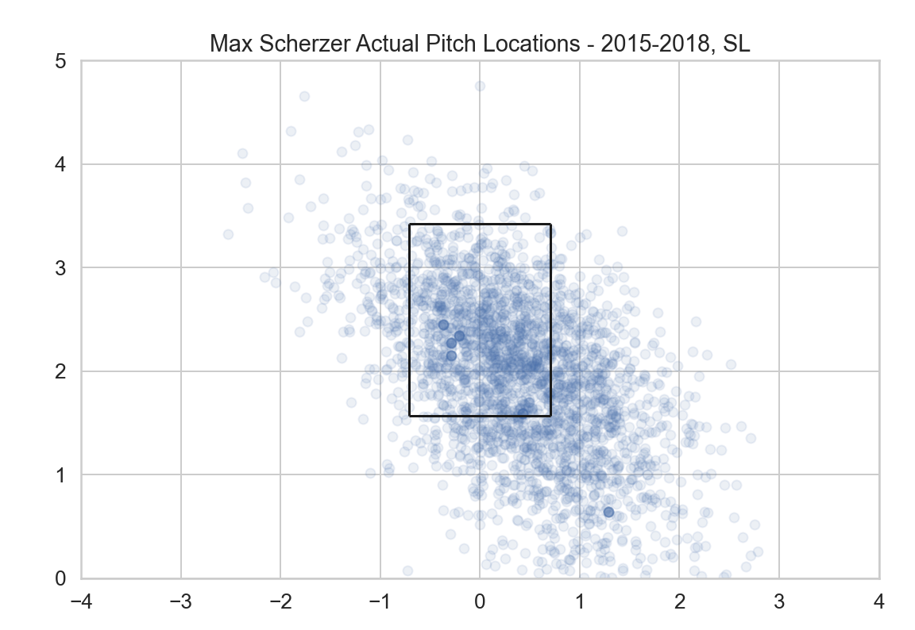
Pitch locations tend to predict in or near the strike zone, possibly showing how a pitcher is trying to throw a certain pitch type.

Slide 27
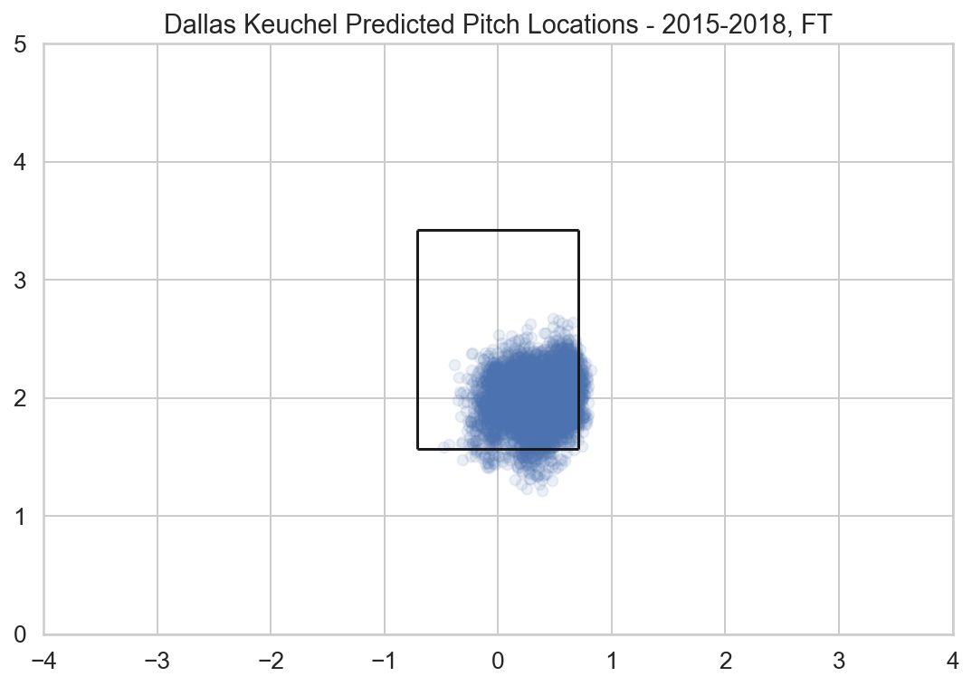
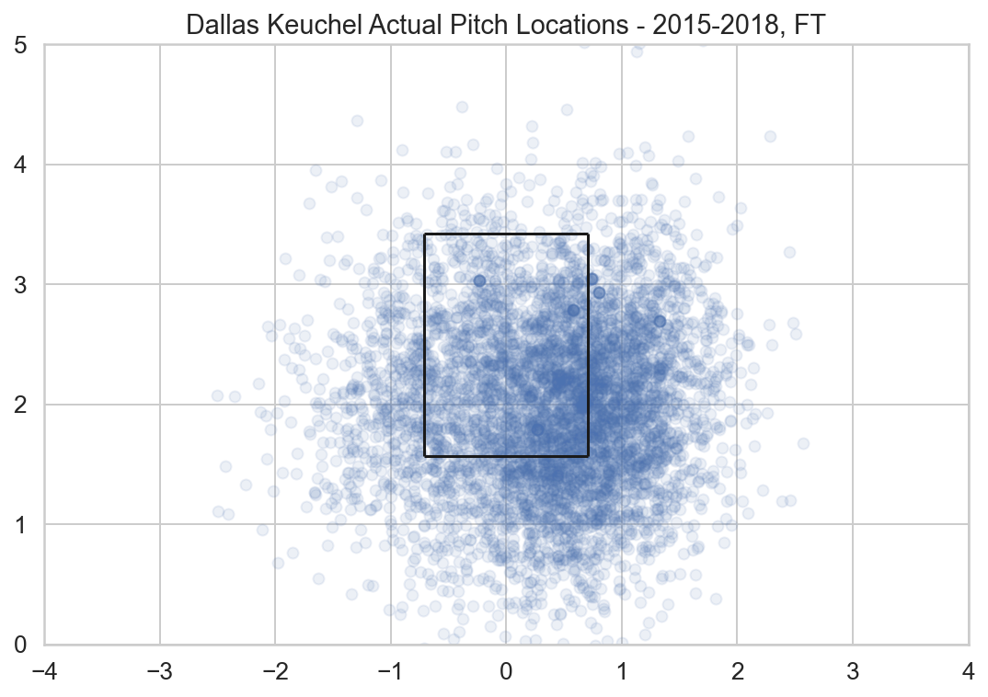
Pitch locations tend to predict in or near the strike zone, possibly showing how a pitcher is trying to throw a certain pitch type.

